Slide 1


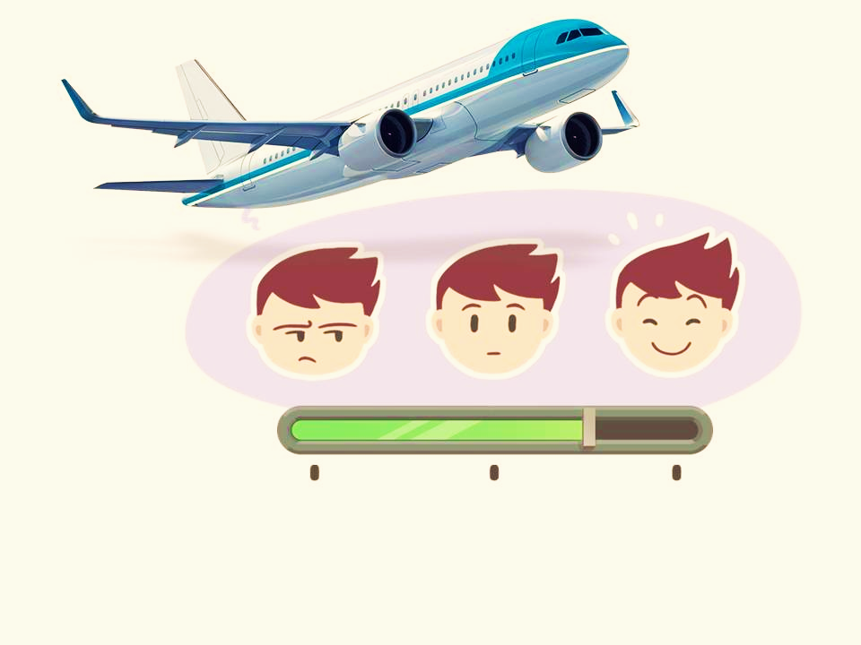
Big Data Project|2024
Airline Passenger Satisfaction
Presented By : Team 13
Supervised by: Eng. Omar Samir

Slide 2
1
OVERVIEW
1-Motivation
2-Project Pipeline
3-Data Preparation
4-EDA
5-Preprocessing
6-Model Building & Evaluation
Cairo University | 2024

Slide 3
2
PROBLEM
Airline businesses globally are faced with the challenge of grounding especially due to the pandemic. To stay in business, Airline operators need to determine relative parameters that can contribute to the satisfaction of passengers. They aim to determine the relative importance of each parameter with regards to their contribution to passenger satisfaction.
So the problem question is: How can airlines know which factors are most important for/the strongest contributors to customer satisfaction?
Cairo University | 2024

Slide 4
3
MOTIVATION
This study and its findings will help the airline companies to identify the gaps on their service quality and to improve it in future by segregating the important factors. It will mainly help in finding out what are the areas of improvement should be considered and what not in order to increase the customer satisfaction.
Cairo University | 2024

Slide 5

4
PROJECT PIPELINE
Cairo University | 2024

Slide 6
5
DATA PREPARATION
(1) Explore dataset size :
training: 103904 rows × 25 columns.
testing: 25976 rows × 25 columns.
(2) Explore unique values for each feature.
(3) Remove nulls from dataset.
(4) Remove unnecessary columns ==> id & unnamed:0
(5) Check if there are duplicate rows
Cairo University | 2024

Slide 7
6
DATA PREPARATION
Categorical
Numerical
Age - Flight Diastance - Inflight wifi service
Departure/Arrival time convenient - Cleanliness
Ease of Online booking - Arrival Delay in Minutes
Gate location - Food and drink - Online boarding Seat comfort - Inflight entertainment
On-board service - Leg room service - Baggage handling - Checkin service Inflight service
Departure Delay in Minutes
Gender.
Customer Type.
Type of travel.
Class.
Satisfaction
Cairo University | 2024

Slide 8
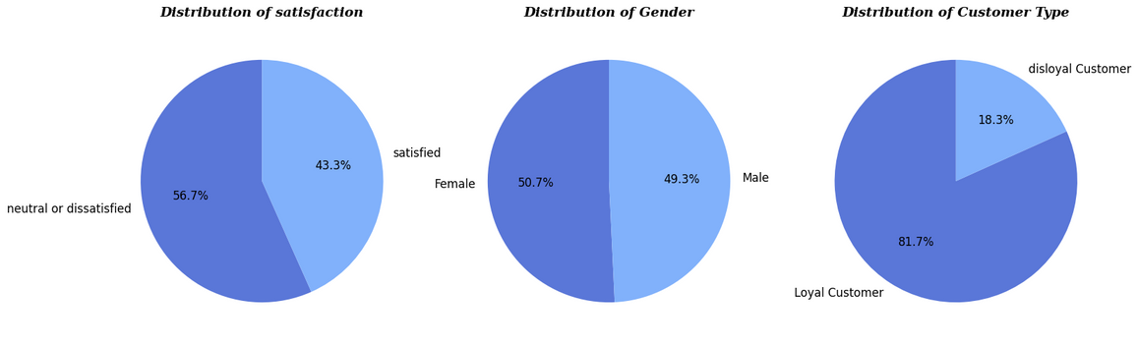
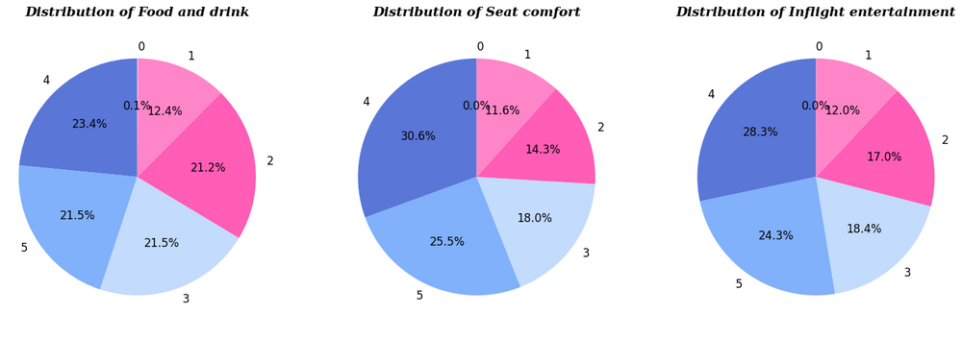
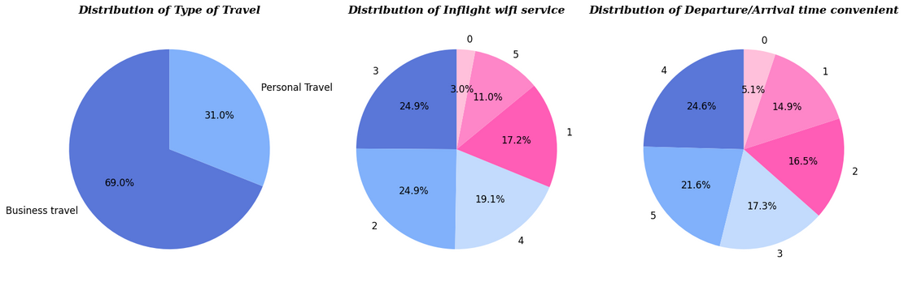
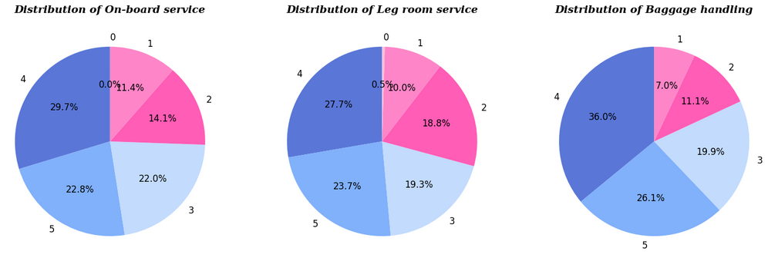
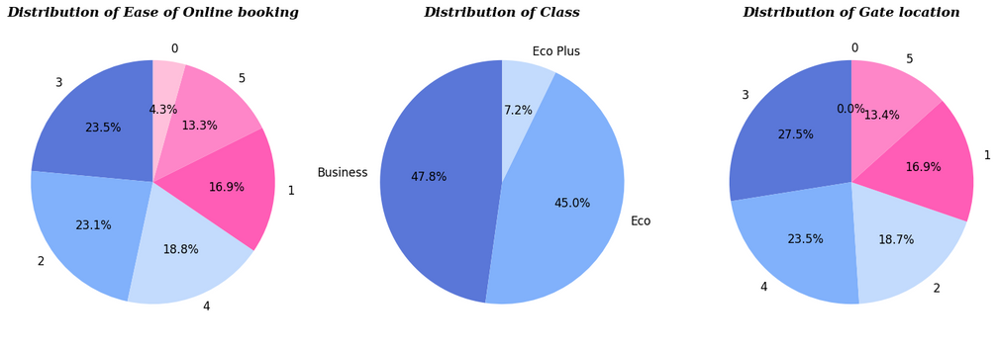
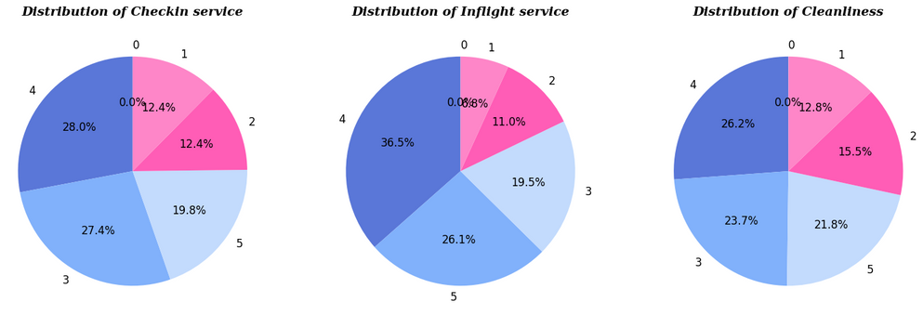
EDA
7
(1) Univariate Analysis:
Pie charts for categorical variables:

Slide 9
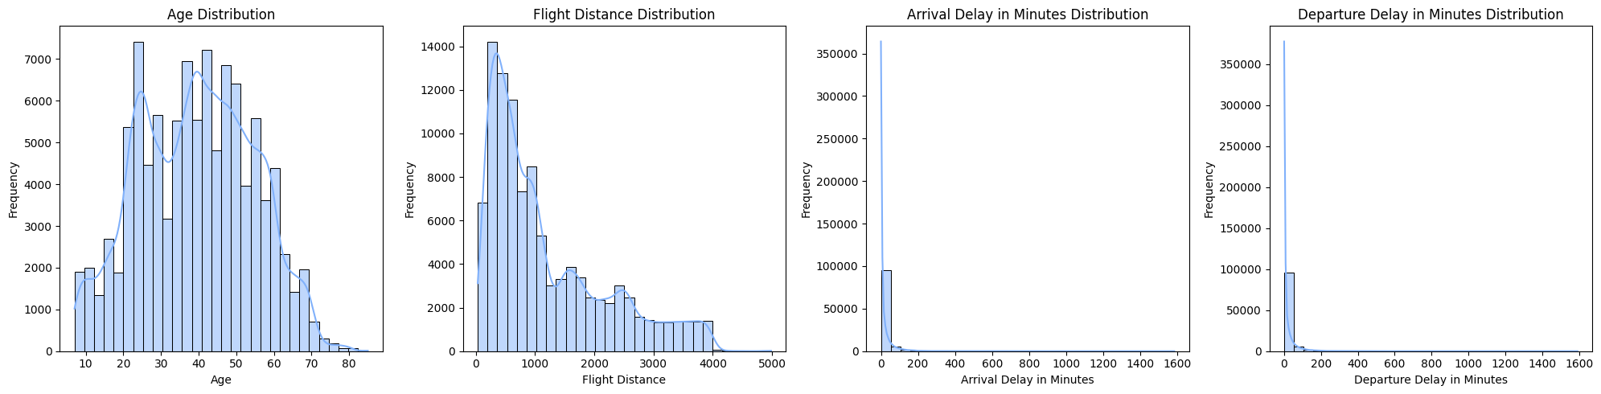
8
EDA
(1) Univariate Analysis:
Histograms for numerical variables:

Slide 10
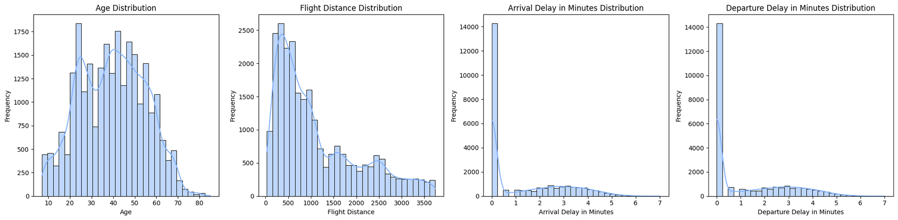
EDA
9
Portion of outliers in each column:
Departure Delay in Minutes 0.139831
Arrival Delay in Minutes 0.134699
Flight Distance 0.022049
Problem of outliers:
Flight Distance
Departure & Arrival Delay in Minutes
Since the portion of rows having the outliers in the "Flight Distance" is very small so we will remove it.
We will normalize "Departure Delay in Minutes","Arrival Delay in Minutes"

Slide 11
EDA
10
(1) Univariate Analysis:
Insights:
1
There is an almost equal number of male and female participants in the survey.
2
Most of travels are for Business travel (69%)
3
Most of passengers are neutral or dissatisfied = 56.7% ==> we need to analysis the reasons and try to find business solutions to make them more satisfied
4
We have more loyal customer data (81.7%)
5
Very few people fly in the economy plus class. They usually prefer Economy or Business.

Slide 12
EDA
10
(1) Univariate Analysis:
Insights:
6
Proportion of rows with 0 values in column 'Departure Delay in Minutes' to total rows: 0.5646
7
Proportion of rows with 0 values in column 'Arrival Delay in Minutes' to total rows: 0.56
8
Most of the delays are 0, which is a good indicator.
The variables Flight Distance and Departure Delay and Arrival Delay are all heavily right-skewed.
9
5
The variables Departure Delay and Arrival Delay are still heavily right-skewed which is expected as most of the values are 0

Slide 13
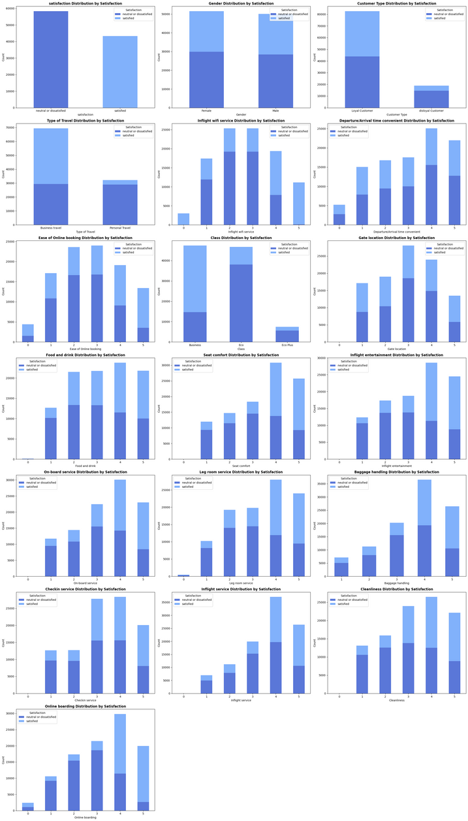
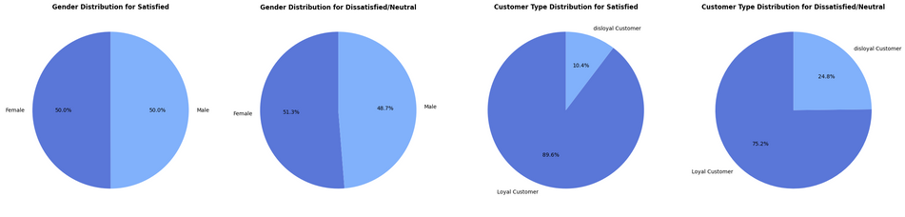
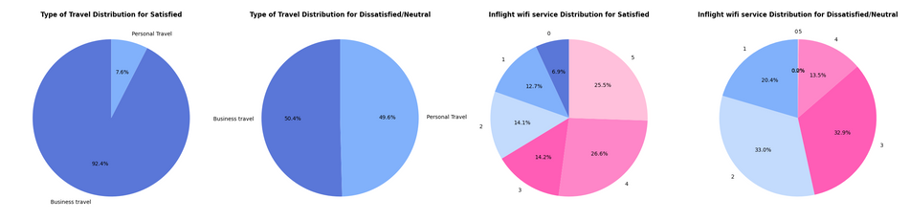
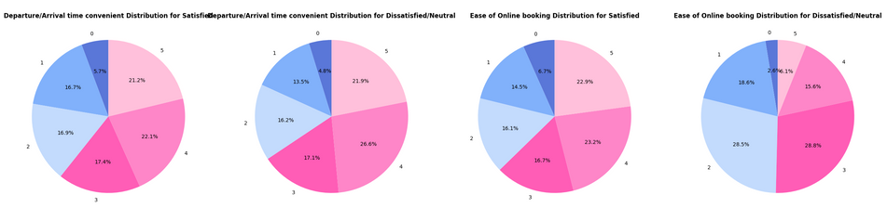
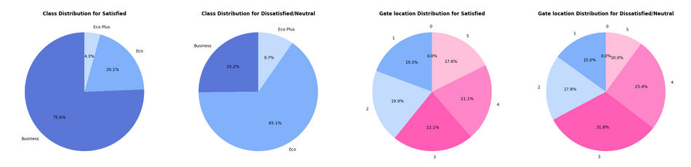
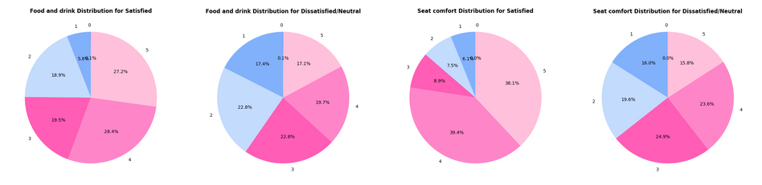
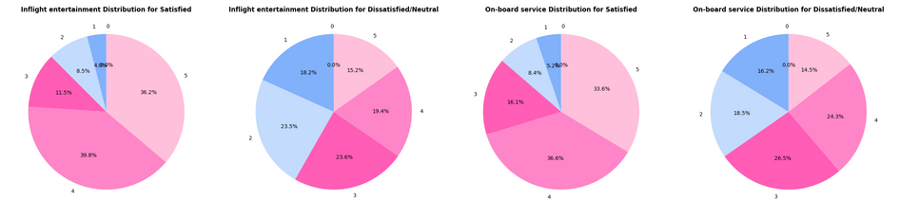
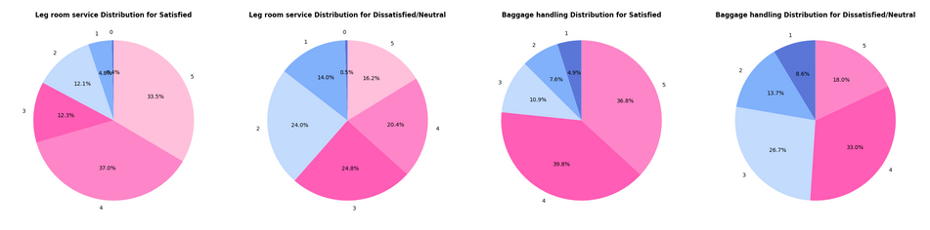
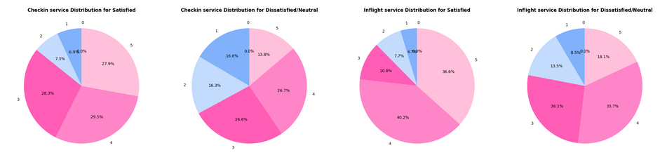
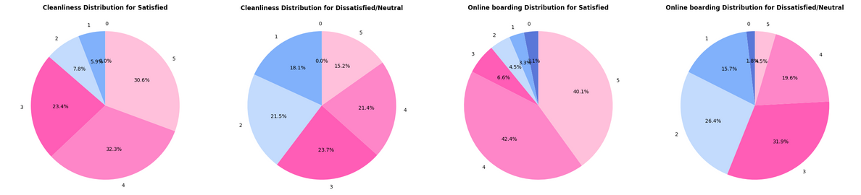
EDA
11
(2) Bivariate Analysis:

Slide 14
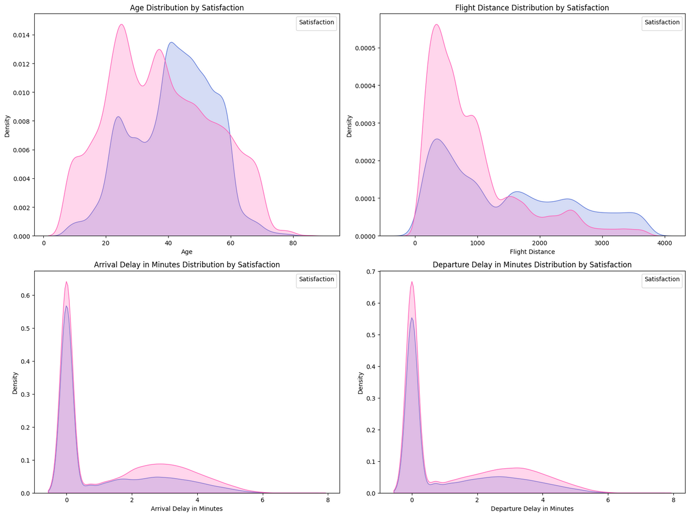
EDA
12
(2) Bivariate Analysis:

Slide 15
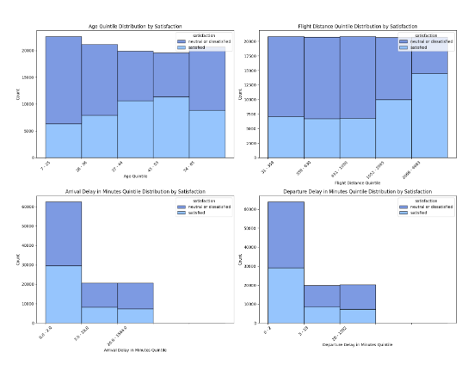
EDA
12
(2) Bivariate Analysis:

Slide 16
EDA
13
(1) Bivariate Analysis:
Insights:
1
Gender nearly doesn't affect satisfaction.
Loyal passengers have higher satisfaction percentages than Disloyal ones.
2
3
Satisfied Passengers usually go for Business travel.
4
Most people of Passengers going for Personal Travel are not satisfied.
5
Satisfied Passengers use Business Class while travelling.
6
Passengers using Eco travelling are the least Satisfied Passengers.

Slide 17
EDA
14
(1) Bivariate Analysis:
Insights:
7
More than 80% of passengers flying in economy are either Neutral or Dissatisfied. That shows us that it needs some improvement
8
Most Satisfied Passengers are in range [37-53] year & Most Unsatisfied are in range [7-36] year
9
atisfied Passengers have more long-distance flights than the dissatisfied.
10
The more the delay the less the satisfied passenger's portion.
11
The most frequency in the levels of satisfaction is 4 for all except: [Inflight Wi-Fi service, Ease of Online booking, Gate location] is 3
12
Rate 3 is the most frequent between unsatisfied passengers in services

Slide 18
EDA
15
(1) Bivariate Analysis:
Insights:
13
Rate 4 is the most frequent between satisfied passengers in services
14
The ratings are almost evenly distributed between 1 and 5. With that in mind, the positive thing is that there are more positive or neutral ratings (3 through 5) than negative ones (0 through 2).
15
Our passengers have mixed opinions about the Departure and Arrival Time Convenience.
We concluded that there is not that much correlation between total Satisfaction
and Departure and Arrival Time Convenience.

Slide 19
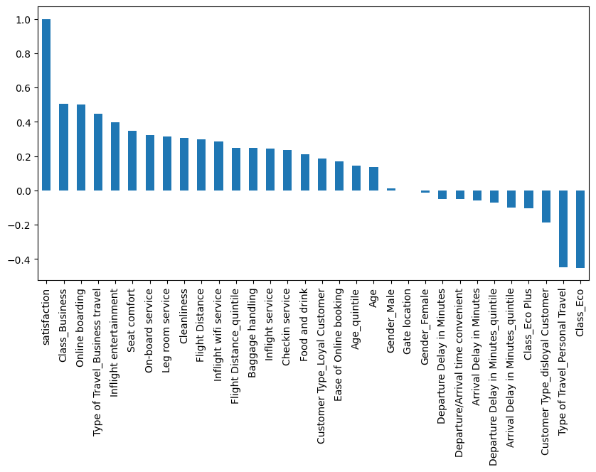
EDA
16
(2) Bivariate Analysis:
Correlation between satisfaction and other features:
Insights
Positively Correlated:
- Business Class ,online boarding, inflight entertainment, seat comfort, on-board service, Legroom service, cleanliness, Flight distance,
and Business travels are strong reasons for people satisfaction.
Negatively Correlated:
- Personal Travels, Economy Class, Eco plus Class or being Disloyal Customer results in Unsatisfaction.

Slide 20
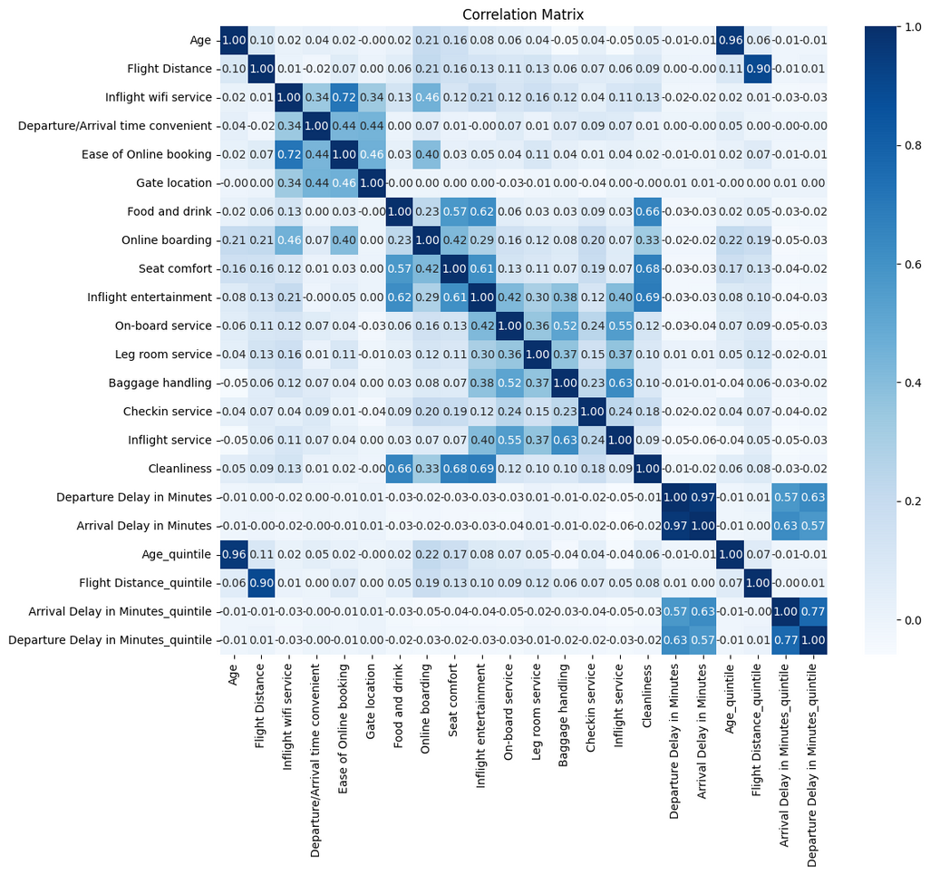
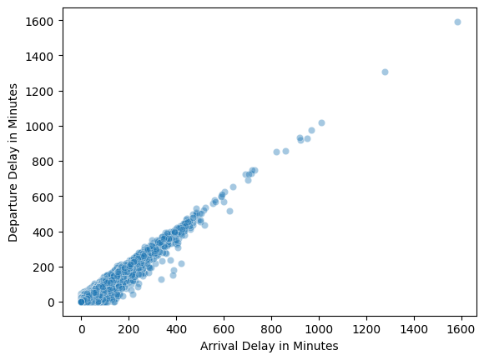
EDA
17
(2) Multivariate Analysis:
Insights
1- Departure Delay is highly correlated with Arrival Delay. [Will deal with this in feature engineering].
2- Inflight WiFi service and Ease of online booking are + correlated.
3- Inflight entertainment, Food and Drink, Seat comfort and cleanliness are + correlated .
4- Baggage handling is + correlated with Inflight service.
Insights
- There is a strong correlation between the two columns.
we can drop one of the two columns and as Arrival Delay in Minutes column has some null, we can drop it.

Slide 21
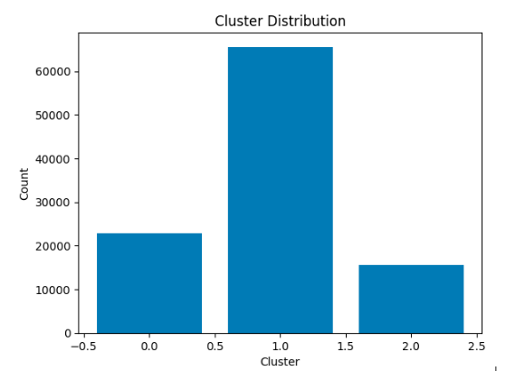
CLUSTERING
18
Applying Kmeans on the data with 3 clusters:
The portion of each class:
Class 1 ==> 0.630900
Class 0 ==> 0.219453
Class 2 ==> 0.149648
Most of the data (63%) is in one cluster (cluster 1)

Slide 22
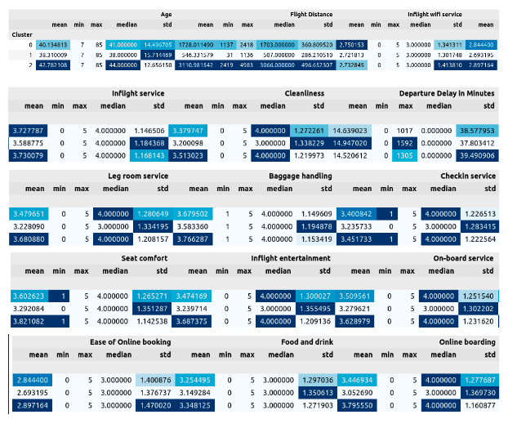
CLUSTERING
19
showing aggregates of each numeric column grouped by the cluster
Insights:
All age values are in the 3 clusters [7-85]
Flight Distances is distributed on all clusters without intersection between them:
Cluster 1 contains flight distance in the range [1137:2418]
Cluster 0 contains flight distance in the range [31:1136]
Cluster 2 contains flight distance in the range [2419:4983]
Value 0 for seat comfort column is only in cluster 1
Value 0 for Checkin service column is only in cluster 1
Values in range [1017:1592] don't exist in class 0
Values in range [1305:1592] don't exist in class 2

Slide 23
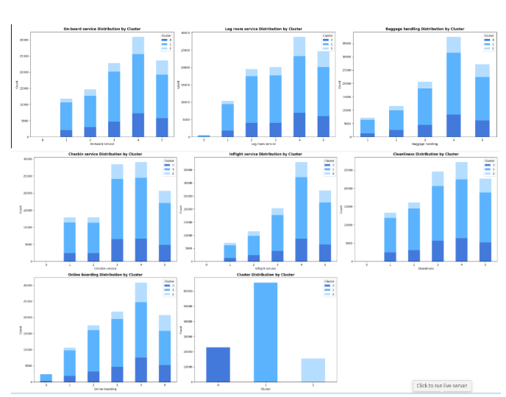
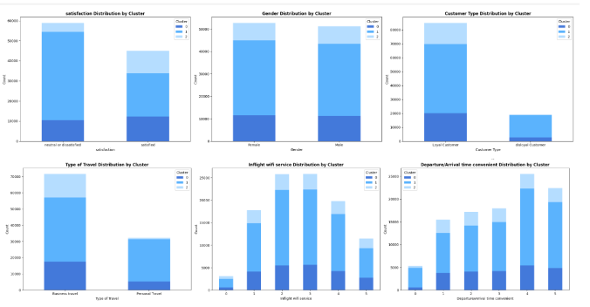
CLUSTERING
20
Show the cluster distribution over the categories of categorical features

Slide 24
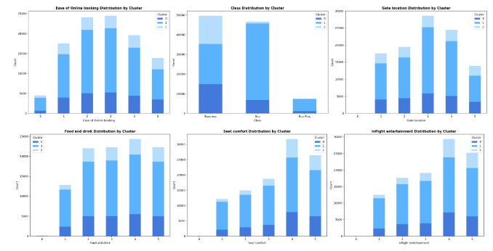
CLUSTERING
21
Insights:
Cluster 1 is the major class in all values in all columns
Satisfied customers are distributed over all cluster
Dissatisfied or neutral customers are distributed over all cluster
Each gender is distributed over all clusters
Loyal customer is distributed over all clusters
Cluster 2 doesn't contain Disloyal customers
The portion of customers with type of travel is personal in cluster 2 is very small
All values of [Inflight WiFi service, departure arrival time convenient, Ease of online booking, Gate Location, Food and drink,
seat comfort, inflight entertainment, on-board service, Baggage handling, Checkin service, inflight service & cleanliness] are distributed over all clusters
The portion of departure arrival time convenient with value 0 in cluster 2 is very small
Cluster 2 doesn't contain customers of Eco plus class
The portion of of customers of Eco class in cluster 2 is very small
Cluster 2 doesn't contain values 0 of Online boarding
Values 0 of Leg room service are all in cluster 1
Show the cluster distribution over the categories of categorical features

Slide 25
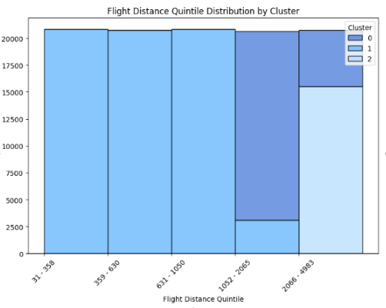
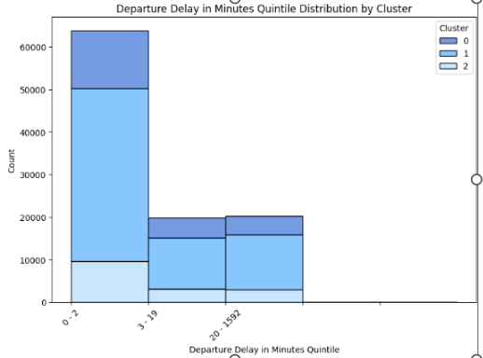
CLUSTERING
22

Slide 26
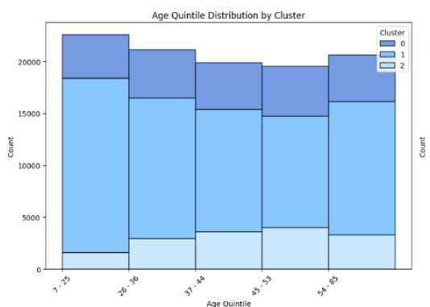
CLUSTERING
23
Insights:
Cluster 1 is the major class in all values in all columns
Satisfied customers are distributed over all cluster
Dissatisfied or neutral customers are distributed over all cluster
Each gender is distributed over all clusters
Loyal customer is distributed over all clusters
Cluster 2 doesn't contain Disloyal customers
The portion of customers with type of travel is personal in cluster 2 is very small
All values of [Inflight WiFi service, departure arrival time convenient, Ease of online booking, Gate Location, Food and drink,
seat comfort, inflight entertainment, on-board service, Baggage handling, Checkin service, inflight service & cleanliness] are distributed over all clusters
The portion of departure arrival time convenient with value 0 in cluster 2 is very small
Cluster 2 doesn't contain customers of Eco plus class
The portion of of customers of Eco class in cluster 2 is very small
Cluster 2 doesn't contain values 0 of Online boarding
Values 0 of Leg room service are all in cluster 1

Slide 27
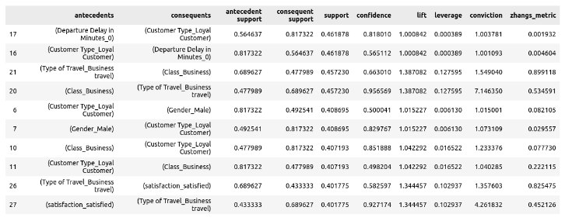
ASSOCIATION RULES
24
Applying Apriori algorithm with minimum support = 0.25 and minimum cardinality = 2
Top 10 rules sorted by support:

Slide 28
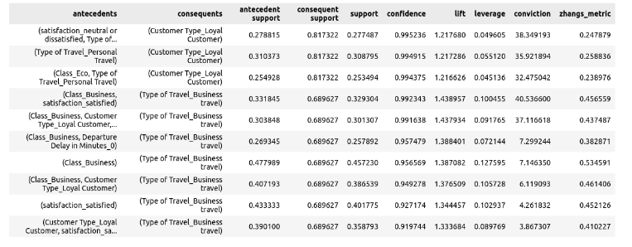
ASSOCIATION RULES
25
Top 10 rules sorted by confidence:

Slide 29
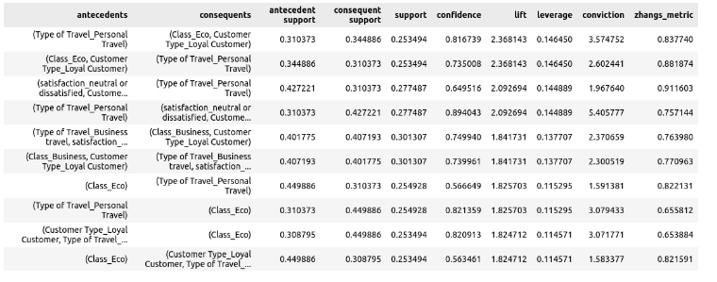
ASSOCIATION RULES
26
Top 10 rules sorted by lift:

Slide 30
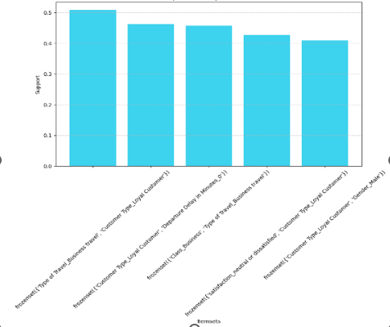
ASSOCIATION RULES
27
Top 5 frequent items:
Most frequent 2-itemset:
{'Type of Travel_Business travel', 'Customer Type_Loyal Customer'}
Frequency: 0.5085

Slide 31
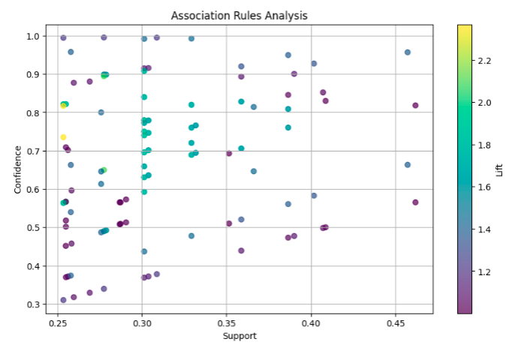
ASSOCIATION RULES
28

Slide 32
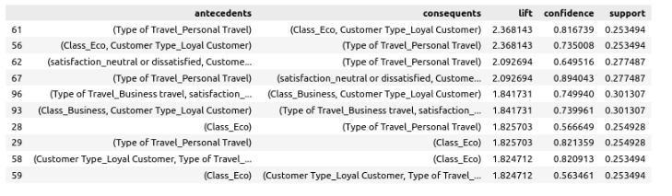
ASSOCIATION RULES
29
Insights:
If a customer's type of travel is "Personal Travel", then there is a strong association with the customer being classified as "Eco" class and a "Loyal Customer".
The lift value of 2.3681 indicates that the occurrence of the antecedent and consequent together is 2.3681 times more likely than if they were statistically independent.
This means that customers who travel for personal reasons are 2.3681 times more likely to be classified as "Eco" class and "Loyal Customers" compared to what would be expected if these attributes were unrelated.
The confidence value of 0.8167 indicates that 81.67% of the transactions that contain "Personal Travel" also contain "Eco" class and "Loyal Customer".
The support value of 0.2535 indicates that 25.35% of the transactions contain both "Personal Travel" and "Eco" class and "Loyal Customer".
Top 10 rules sorted by lift:

Slide 33
ASSOCIATION RULES
30
If a customer is classified as "Eco" class and is a "Loyal Customer", then there is a strong association with their type of travel being "Personal Travel".
The lift value of 2.3681 indicates that the occurrence of the consequent given the antecedent is 2.3681 times more likely than if they were statistically independent.
This means that customers who are classified as "Eco" class and "Loyal Customers" are 2.3681 times more likely to travel for personal reasons compared to what would be expected if these attributes were unrelated.
The confidence value of 0.7350 indicates that 73.50% of the transactions that contain "Eco" class and "Loyal Customer" also contain "Personal Travel".
The support value of 0.2535 indicates that 25.35% of the transactions contain both "Eco" class and "Loyal Customer", and "Personal Travel".
If a customer is classified as a "Loyal Customer" and their satisfaction level is "neutral or dissatisfied", then there is a strong association with their type of travel being "Personal Travel".
The lift value of 2.0927 indicates that the occurrence of the consequent given the antecedent is 2.0927 times more likely than if they were statistically independent.
This means that if a customer is classified as a "Loyal Customer" and their satisfaction level is "neutral or dissatisfied", there is 2.0927 times more likely that their type of travel will be "Personal Travel" compared to what would be expected if these attributes were unrelated.
The confidence value of 0.6495 indicates that 64.95% of the transactions that contain "Loyal Customer" with a satisfaction level of "neutral or dissatisfied" also contain "Personal Travel".
The support value of 0.2775 indicates that 27.75% of the transactions contain both "Loyal Customer" with a satisfaction level of "neutral or dissatisfied", and "Personal Travel".

Slide 34
ASSOCIATION RULES
31
If a customer's type of travel is "Personal Travel", then there is a strong association with the customer being classified as a "Loyal Customer" and having a satisfaction level of "neutral or dissatisfied".
The lift value of 2.0927 indicates that the occurrence of the consequent given the antecedent is 2.0927 times more likely than if they were statistically independent.
This means that if a customer's type of travel is "Personal Travel", there is a higher likelihood that the customer will be classified as a "Loyal Customer" and have a satisfaction level of "neutral or dissatisfied" compared to what would be expected if these attributes were unrelated.
The confidence value of 0.8940 indicates that 89.40% of the transactions that contain "Personal Travel" also contain "Loyal Customer" with a satisfaction level of "neutral or dissatisfied".
The support value of 0.2775 indicates that 27.75% of the transactions contain both "Personal Travel" and "Loyal Customer" with a satisfaction level of "neutral or dissatisfied".
If a customer's type of travel is "Business travel" and their satisfaction level is "satisfied", then there is a moderate association with the customer being classified as "Business" class and a "Loyal Customer".
The lift value of 1.8417 indicates that the occurrence of the consequent given the antecedent is 1.8417 times more likely than if they were statistically independent.
The confidence value of 0.7499 indicates that 74.99% of the transactions that contain "Business travel" with a satisfaction level of "satisfied" also contain "Business" class and "Loyal Customer".
The support value of 0.3013 indicates that 30.13% of the transactions contain both "Business travel" with a satisfaction level of "satisfied", and "Business" class and "Loyal Customer".

Slide 35
ASSOCIATION RULES
32
If a customer is classified as "Business" class and is a "Loyal Customer", then there is a moderate association with their type of travel being "Business travel" and their satisfaction level being "satisfied".
The lift value of 1.8417 indicates that the occurrence of the consequent given the antecedent is 1.8417 times more likely than if they were statistically independent.
The confidence value of 0.7400 indicates that 74.00% of the transactions that contain "Business" class and "Loyal Customer" also contain "Business travel" with a satisfaction level of "satisfied".
The support value of 0.3013 indicates that 30.13% of the transactions contain both "Business" class and "Loyal Customer", and "Business travel" with a satisfaction level of "satisfied".
If a customer is classified as "Eco" class, then there is a moderate association with their type of travel being "Personal Travel".
The lift value of 1.8257 indicates that the occurrence of the consequent given the antecedent is 1.8257 times more likely than if they were statistically independent.
The confidence value of 0.5666 indicates that 56.66% of the transactions that contain "Eco" class also contain "Personal Travel".
The support value of 0.2549 indicates that 25.49% of the transactions contain both "Eco" class and "Personal Travel".

Slide 36
ASSOCIATION RULES
33
If a customer's type of travel is "Personal Travel", then there is a strong association with the customer being classified as "Eco" class.
The lift value of 1.8257 indicates that the occurrence of the consequent given the antecedent is 1.8257 times more likely than if they were statistically independent.
The confidence value of 0.8214 indicates that 82.14% of the transactions that contain "Personal Travel" also contain "Eco" class.
The support value of 0.2549 indicates that 25.49% of the transactions contain both "Personal Travel" and "Eco" class.
If a customer is classified as a "Loyal Customer" and their type of travel is "Personal Travel", then there is a strong association with the customer being classified as "Eco" class.
The lift value of 1.8247 indicates that the occurrence of the consequent given the antecedent is 1.8247 times more likely than if they were statistically independent.
The confidence value of 0.8209 indicates that 82.09% of the transactions that contain both "Loyal Customer" and "Personal Travel" also contain "Eco" class.
The support value of 0.2535 indicates that 25.35% of the transactions contain both "Loyal Customer" and "Personal Travel", and "Eco" class.

Slide 37
34
PREPROCESSING
(1) Encode categorical variables.
(2) Drop Arrival delay in minutes column
(3) Drop unnecessary columns (columns that don’t affect satisfaction)
[Gender, Gate location, Departure/Arrival time convenient]
(4) Apply grouping on features with continuous variables
(5) Standardization: scaling features by subtracting the mean and then dividing by the standard deviation.
This results in features that have a mean of 0 and a standard deviation of 1.

Slide 38
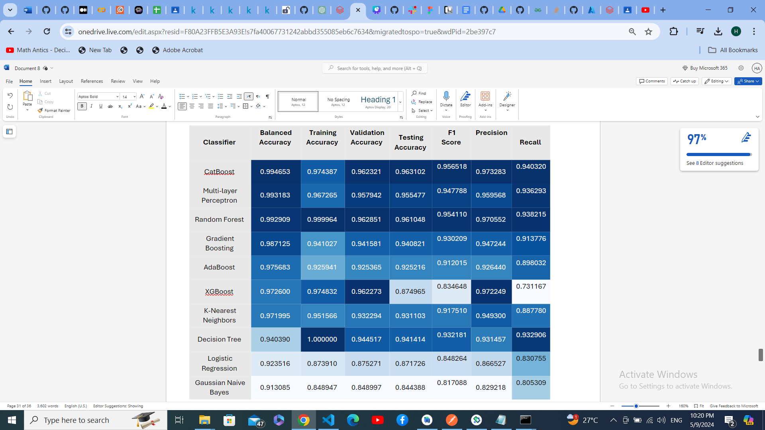
MODEL BUILDING & EVALUATION
35
CatBoost achieved the highest F1 Score & Balanced Accuracy

Slide 39
36
NB from sklearn
Multi Nominal Naive Bayes without applying grouping on features with continuous variables from sklearn:
Balanced Accuracy: 0.8741036230929793
Training Accuracy: 0.7680455035417308
Testing Accuracy: 0.7649034093153716
Validation Accuracy: 0.7680455332217699
F1 Score: 0.7330791657322269
Precision: 0.7187335092348285
Recall: 0.7480091533180778
Multi Nominal Naive Bayes with applying grouping on features with continuous variables from sklearn:
Balanced Accuracy: 0.8660401815904305
Training Accuracy: 0.7687865722205113
Testing Accuracy: 0.7656145063801209
Validation Accuracy: 0.7687288538824919
F1 Score: 0.7336236699142458
Precision: 0.7199506520972858
Recall: 0.7478260869565218

Slide 40
37
Map Reduce NB
Multi Nominal Naive Bayes without applying grouping on features with continuous variables from scratch using map reduce:
Balanced Accuracy: 0.7650422898817919
Training Accuracy: 0.8885220973206036
Testing Accuracy: 0.7626516019436653
f1_score: 0.7399809573271012
precision: 0.7018307199737296
recall: 0.7825171624713959
Multi Nominal Naive Bayes with applying grouping on features with continuous variables from scratch using map reduce:
Balanced Accuracy: 0.7611859775085901
Training Accuracy: 0.9015629812134278
Testing Accuracy: 0.7623750641962628
f1_score: 0.7321547846996482
precision: 0.7128858827610128
recall: 0.7524942791762014

Slide 41
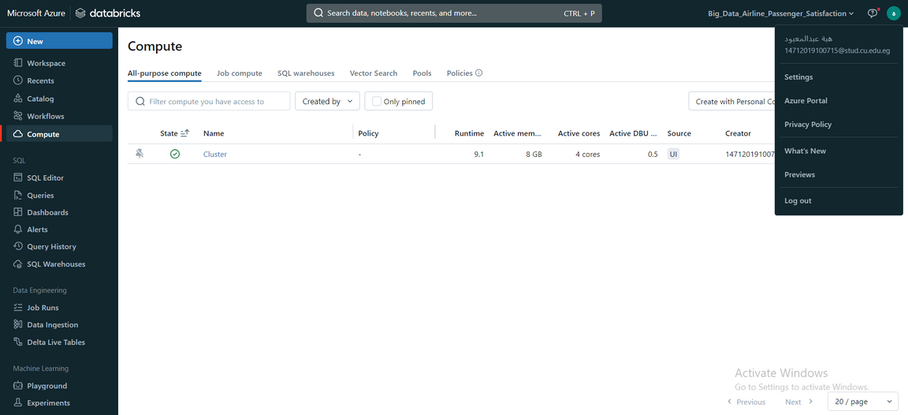
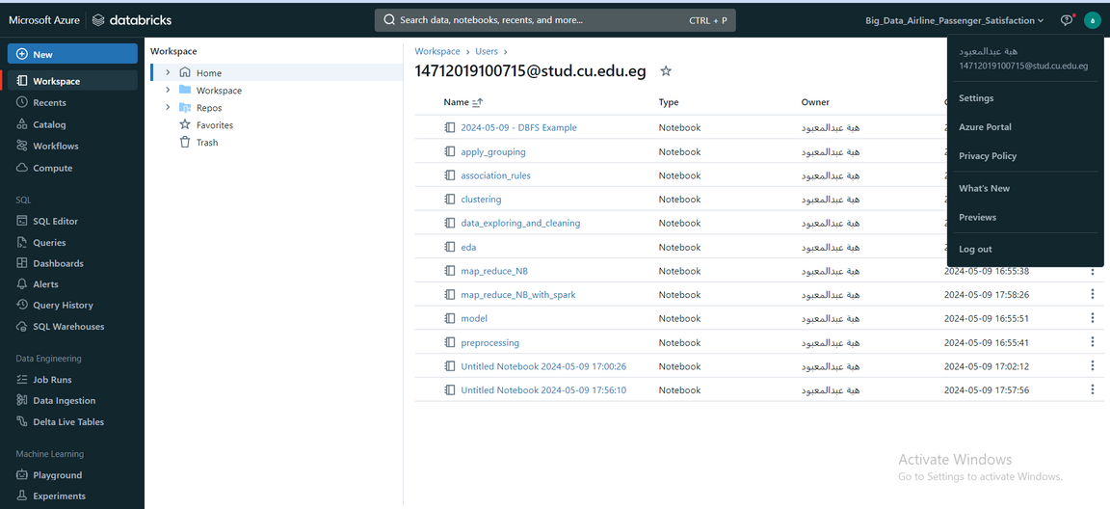
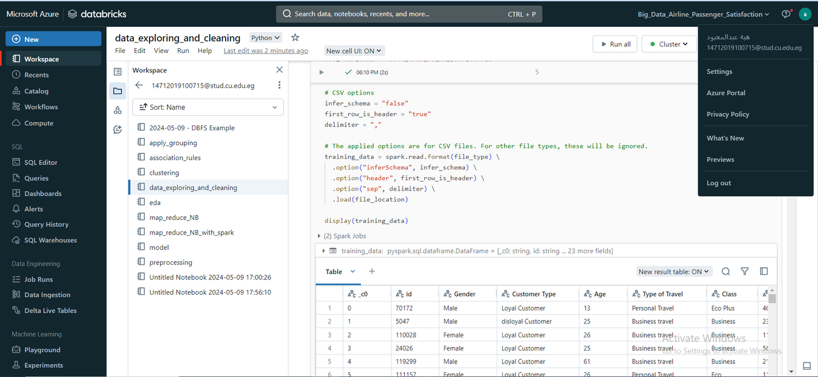
Azure
38

Slide 42
39
Unsuccessful trials
Implementing Naive Bayes with map reduce without spark worked well but with spark we calculated classes prior probabilities and applied training but encountered an error while applying predictions so we couldn’t create the metrics

Slide 43
40
Enhancements and future work
Apply different clustering algorithms
Apply map reduce with spark on different classification and clustering algorithms
Apply grouping on features with continuous values with different number of groups

Slide 44
Thank You

